Slide 1
supply

Slide 2
Law of Supply
As the price a seller can charge for their good or service rises, the quantity supplied will increase
Quantity
Prices
Supply

Slide 3



Example:
  Cardinal Diner makes and sells gingerbread cookies
  It costs them 10¢ to make the cookies so they have to charge at least 10¢ for them.
  They don’t make any money at this price though so they don’t make very many cookies.
  If they can charge 20¢ per cookie they will make 100 cookies to sell
  If they can charge 30¢ per cookie they will make 200 cookies to sell
  Why do they make more?

Slide 4
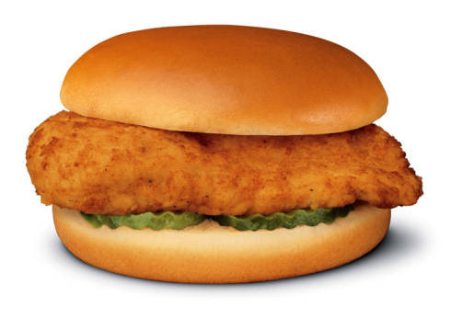
How do we know what price will eventually be charged?
  We use a Supply schedule and a Demand schedule
    A list of quantity supplied and quantity demand at a range of prices
Example:
  Chicken sandwiches
    At $1 consumers will demand
    43 chicken sandwiches but
    producers will only supply 1
Quantity Supplied | Price | Quantity Demand
49 | $7 | 4
39 | $6 | 8
29 | $5 | 13
19 | $4 | 19
12 | $3 | 26
5 | $2 | 34
1 | $1 | 43

Slide 5
Determinants of Supply
  Factors that change supply curve

Slide 6
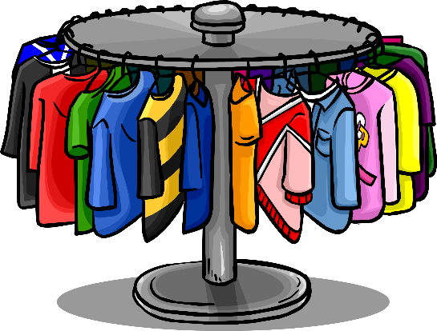


Slide 7



Profits: 50¢ each
Profits: 75¢ each

Slide 8
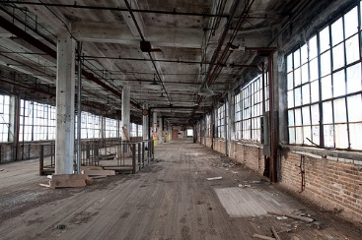
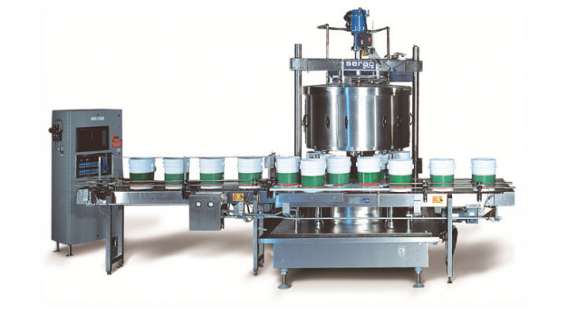
Que dijo?

Slide 9

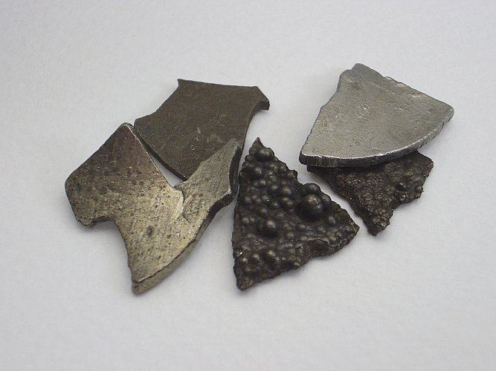
Ooh cheap resources!
I want to make stuff!

Slide 10




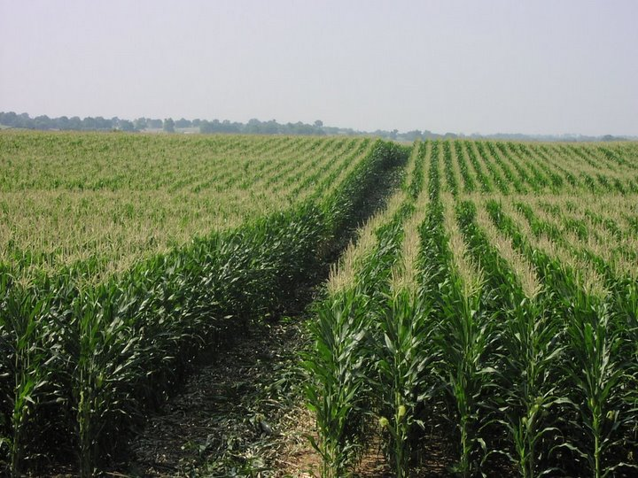

Slide 11
Number of Producers
Taxes and Subsidies
Profit Opportunities of Other goods
Technology
Cost of Resources
Producers Future Price Expectations (prices they can charge)

Slide 12


1. Number of producers
More producers = more supply
Less producers = less supply

Slide 13
2. Taxes and Subsidies
Taxes – what the government charges you
  make it more expensive to produce so supply decreases
Subsidy – what the government pays people to do something
  make it less expensive to produce so supply increases

Slide 14
3. Profit Opportunities Producing Other Goods
Sellers make more profits selling a different product
  They will switch
  Supply of the original good falls
  Supply of the different good rises
Profits: 50¢ each
Profits: 75¢ each

Slide 15

4. Technology
    Technology makes us work faster and more efficiently so producers can make more goods and services

Slide 16
5. Cost of Resources
Costs increase =more expensive to produce
  Good or service supply decreases
Costs decrease =less expensive to produce
  Good or service supply increases

Slide 17

6. Producers Future Price expectations (prices they can charge)
If producers expect prices to FALL in the future they will try to sell as much as possible now so supply increases today
If producers expect prices to RISE in the future they will wait to sell so supply decreases today

