Slide 1
Monetary Policy

Slide 2
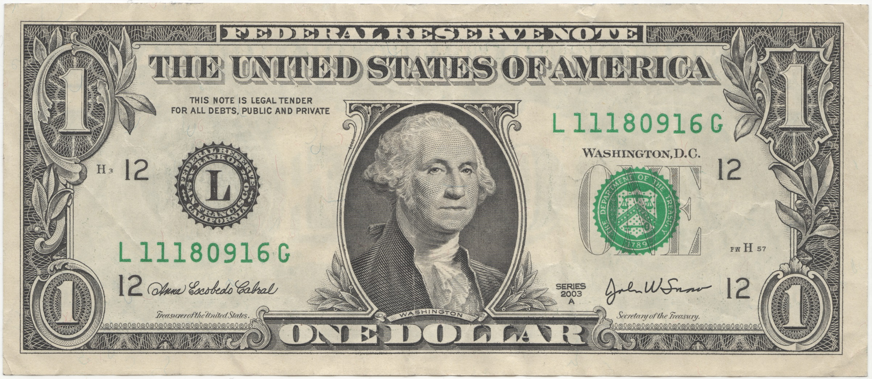
Take out a dollar bill

Slide 3
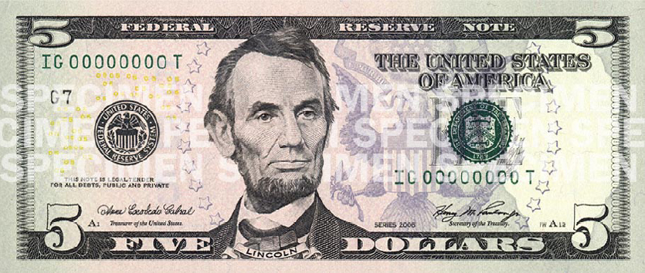

Slide 4
Federal Reserve Banks
Federal Reserve Bank | Letter | Number
Boston | A | 1
New York City | B | 2
Philadelphia | C | 3
Cleveland | D | 4
Richmond | E | 5
Atlanta | F | 6
Chicago | G | 7
St. Louis | H | 8
Minneapolis | I | 9
Kansas City, MO | J | 10
Dallas | K | 11
San Francisco | L | 12

Slide 5
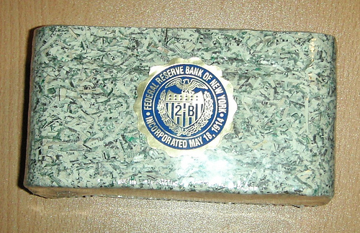
What do you think this is?

Slide 6

Why would you do that?!!!

Slide 7

“The Fed”
We are controlling that money!!!

Slide 8
INFLATION!!
The 1st stage: when the economy has economic growth
GDP is rising
Expansion

Slide 9
3 things the “Fed” can do to get money out of the economy (fix inflation)
1. Sell bonds!
Money out of economy into Fed

Slide 10
Is there anything we can do to maintain a stable economy?
YES!!!

Slide 11
How do we do it?
Monetary Policy (The Fed)
Fiscal Policy (Congress)

Slide 12
The Business Cycle: the regular ups and downs in an economy
Peak:
Highest Point in an economy
Strong Economy
Expansion:
Period of economic growth
GDP
Contraction:
Period of economic slowdown
GDP
(or increasing at a slower rate)
Trough:
Lowest Point in an economy

Slide 13
Money and the Money Supply
Money: anything that is generally accepted as final payment for g/s
Money Supply: Currency (coins and paper $) in the hands of the public plus checking-type accounts
The supply of money in the economy is important for price stability and economic growth.

Slide 14
Key Points about the Money Supply
Too much money in the economy can cause inflation.
Inflation: rise in the average price level of g/s
  Money doesn’t “go as far”…it isn’t worth as much

Slide 15
Too little money in the economy can lead to falling prices and falling production.
Deflation: a decrease in the avg. price level of g/s

Slide 16
Money Supply Continued…
The Federal Reserve controls the money supply through monetary policy.
Monetary Policy works by increasing or decreasing the money supply.

Slide 17
The Federal Reserve System
“The Fed”
The bankers’ bank and the govt’s bank
The Fed Board of Governors:
  7 members appointed by the President, confirmed by the Senate
  President appoints chairperson to a 4 year term

Slide 18
Organization
Board of Governors –
  7 members
Federal Open Market Committee (FOMC) –
  sets Monetary Policy, comprise of Board of Governors plus 5 District Presidents
12 District Banks

Slide 19
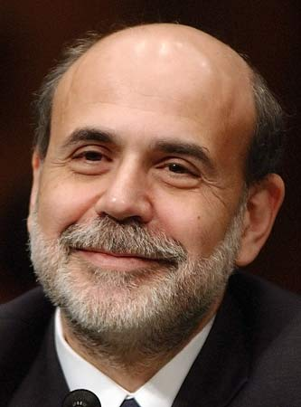
The Fed
Current Chair: Ben Bernanke

Slide 20
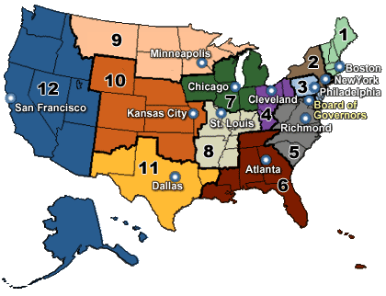
The Fed – 12 Regional Banks
Located in major cities around the country
Each bank has president chosen by board of directors (local business/banking community)

Slide 21
Tools of Monetary Policy
Stimulate Economy – Increase Money Supply
Control Inflation – Decrease Money Supply

Slide 22
Tools of Monetary Policy (3)
Open Market Operations:
  when the Fed buys or sells U.S. govt. securities (bonds)
  Buy securities…more money in circulation (stimulate economy)
  Sell securities…less money in circulation (slow down economy)

Slide 23
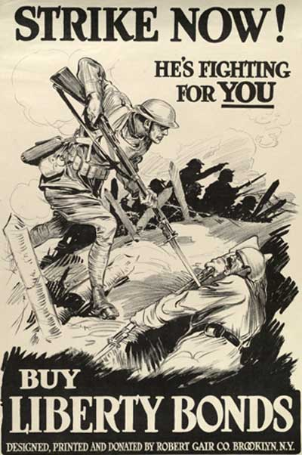
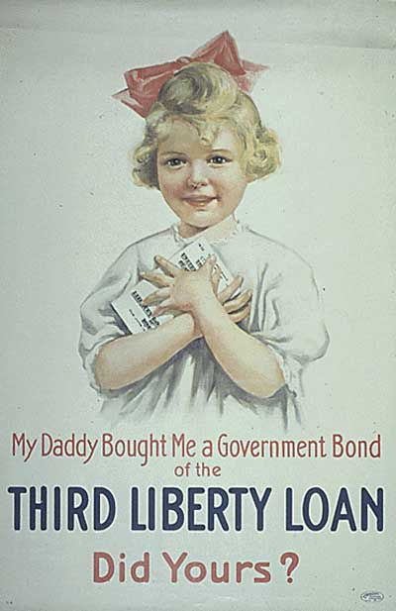
Govt. Bonds/Securities
Essentially…a loan to the US Govt.

Slide 24
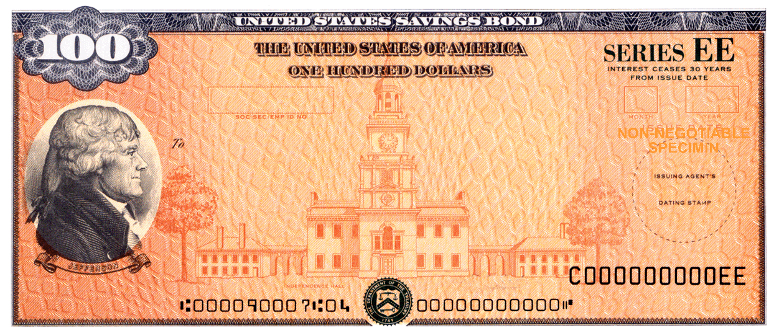
…with a promise of earning interest!

Slide 25
Tools of Monetary Policy:
Changes in Discount Rate:
  The interest rate the Fed charges on loans to banks
  Lower rate…banks are encouraged to make more loans (money supply increases)
  Raise rate…banks are discouraged from making loans (money supply decreases)

Slide 26
Tools of Monetary Policy:
Changes in Reserve Requirement:
  The minimum percentage of deposits that banks must keep on reserve to back up checking-type accounts
  Lower reserve requirement…banks have more money to lend (increases money supply)
  Raise reserve requirement…banks have less to lend (decreases money supply)

