Slide 1

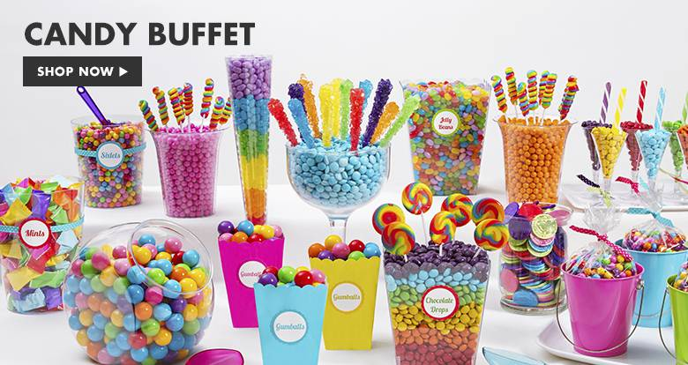

Slide 2
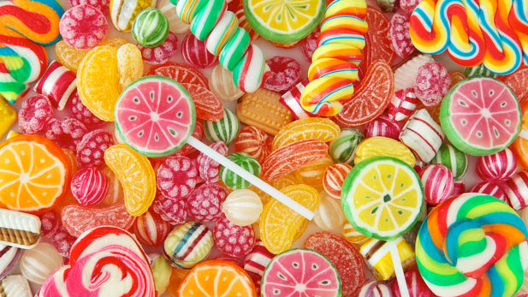

Slide 3
DEMAND- your willingness and ability to buy something
Quantity Demanded: the amount of a g/s that a consumer is willing and able to buy at each particular price (or a specific price)

Slide 4
DEMAND
Quantity Demanded
P
P
Various Possible
Prices
Specific Price
D
D
Qd
Qd

Slide 5
The Law of Demand
(an inverse relationship of Price and Quantity Demanded)
P, Qd
(an increase in price causes a decrease in quantity demanded)
P, Qd
(a decrease in price causes an increase in quantity demanded)

Slide 6
Price
P3
P2
P1
QD3
QD2
QD1
Quantity

Slide 7
Determinants of Demand

Slide 8
What about when price isn’t involved?
What makes the graph get up and move?!

Slide 9
Activator

Slide 10
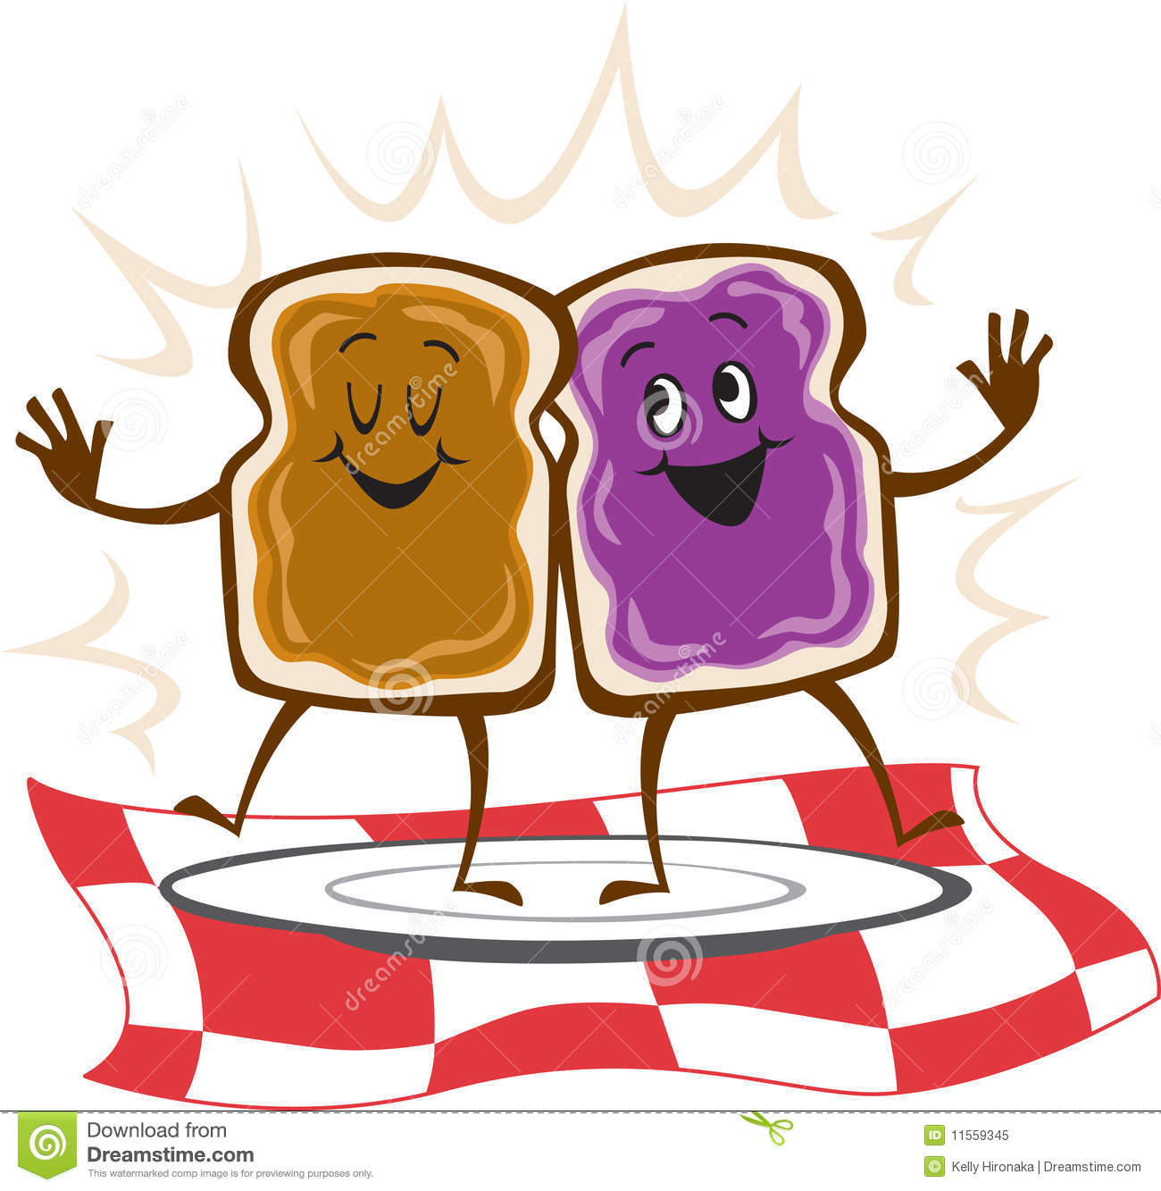
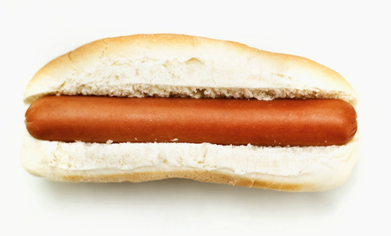
I’m so hungry!

Slide 11

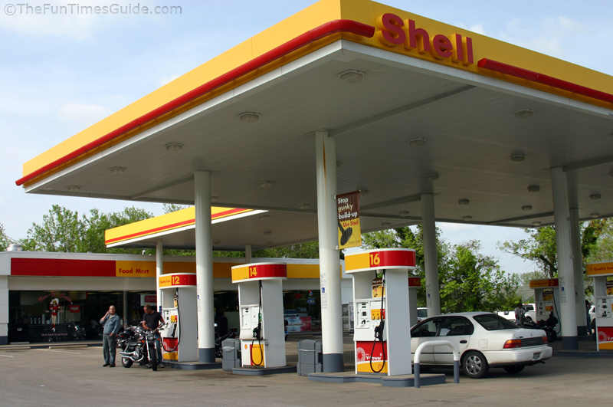
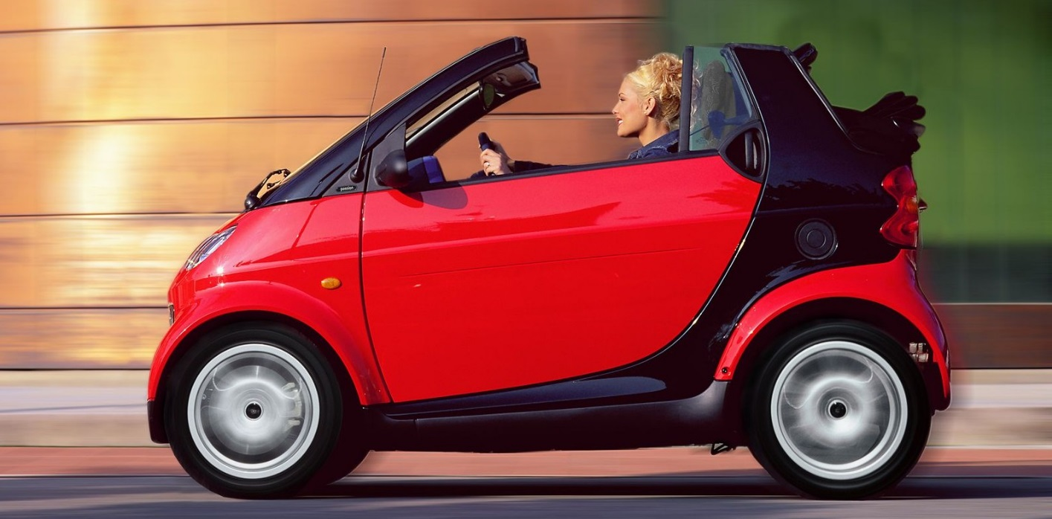

Slide 12
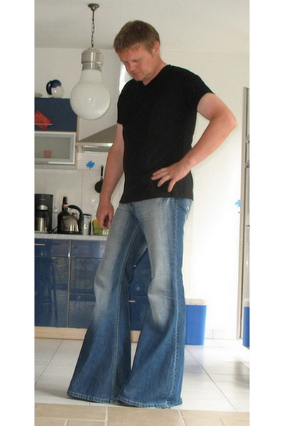

Skinny jeans and bell bottoms
I love skinny jeans!

Slide 13
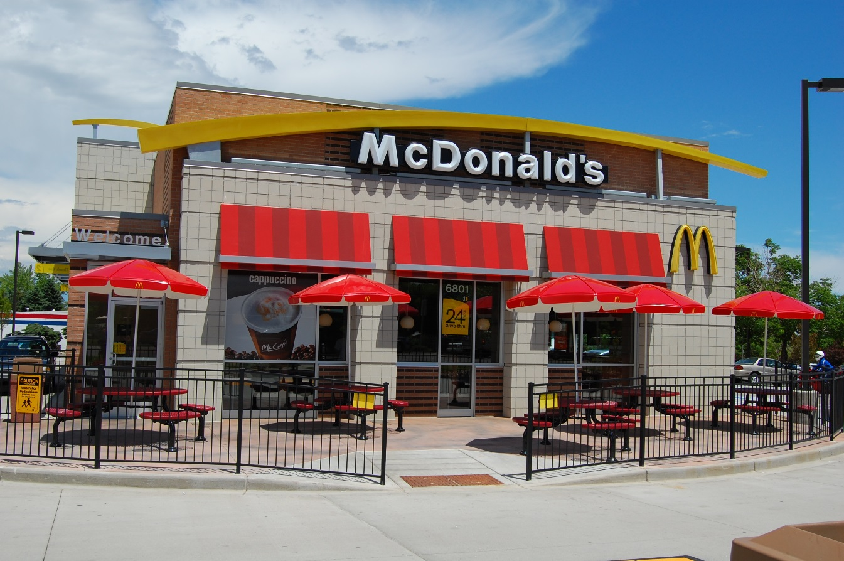
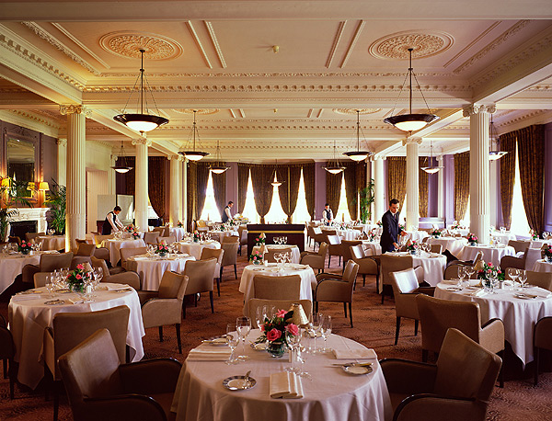
Pay cut at work
McDonalds for dinner? Fancy Restaurant?

Slide 14

Sale this Friday, what happens to your demand today?

Slide 15
I ncome
N umber of consumers
S ubstitute goods
E Expectations (future)
C omplementary goods
T aste and Preferences

Slide 16
Do demand and supply graphs stay
the same
or
do they change?

Slide 17
Answer:
They Change!
But why?

Slide 18
Lots of things can change a supply or demand graph
Prices for the goods and services can change
  This causes the quantity demand and quantity supplied to change so we move ALONG the curve to a new point

Slide 19
What would cause the whole curve to move?
  All new quantities at the same prices?

Slide 20
Answer: any change other than the price of the good or service!

Slide 21
These influences are called Determinants of Demand

Slide 22


1. Number of consumers
More consumers = more demand no matter what price is charged
Less consumers = less demand no matter hat price is charged

Slide 23


2. Taste and Preferences
If something becomes popular, demand goes up no matter what price is charged
If something is no longer popular, demand goes down no matter what price is charged

Slide 24
Tastes and Preferences
Trends change demand
Ex. Boy Bands
D2
D2
D1
D1
D3
Late 90s
Today

Slide 25


Slide 26
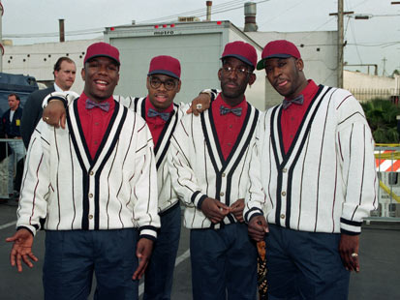

Slide 27


Slide 28


Other Scenarios…
Britney Spears
Ricky Martin…Livin’ La Vida Loca???

Slide 29


3. Income
Income rises = demand increases no matter what price is charged
Income falls = demand falls no matter what price is charged

Slide 30
4. Price of substitute goods
Substitute good – something you buy instead of something else
  If the price of the substitute good falls, demand for the regular good falls
    Example if ketchup goes on sale, demand for mustard will fall (mustard price has not changed)
  If the price of the substitute good rises, demand for the regular good increases
    Example if ketchup goes up in price, demand for mustard will increase (mustard price has not changed)

Slide 31
Jeans are too much!
Switch to Khakis!
P2
P1
D2
D1
Qd2
Qd1
Jeans
Khakis

Slide 32
5. Price of complementary goods
Complementary goods – two or more goods you buy together
If the price of a complementary good increases, the quantity demand of that good will fall AND the demand for the regular good will decrease (it’s price does not change)
  Ex. If peanut butter goes up in price, QD of peanut butter falls AND demand for jelly falls

Slide 33
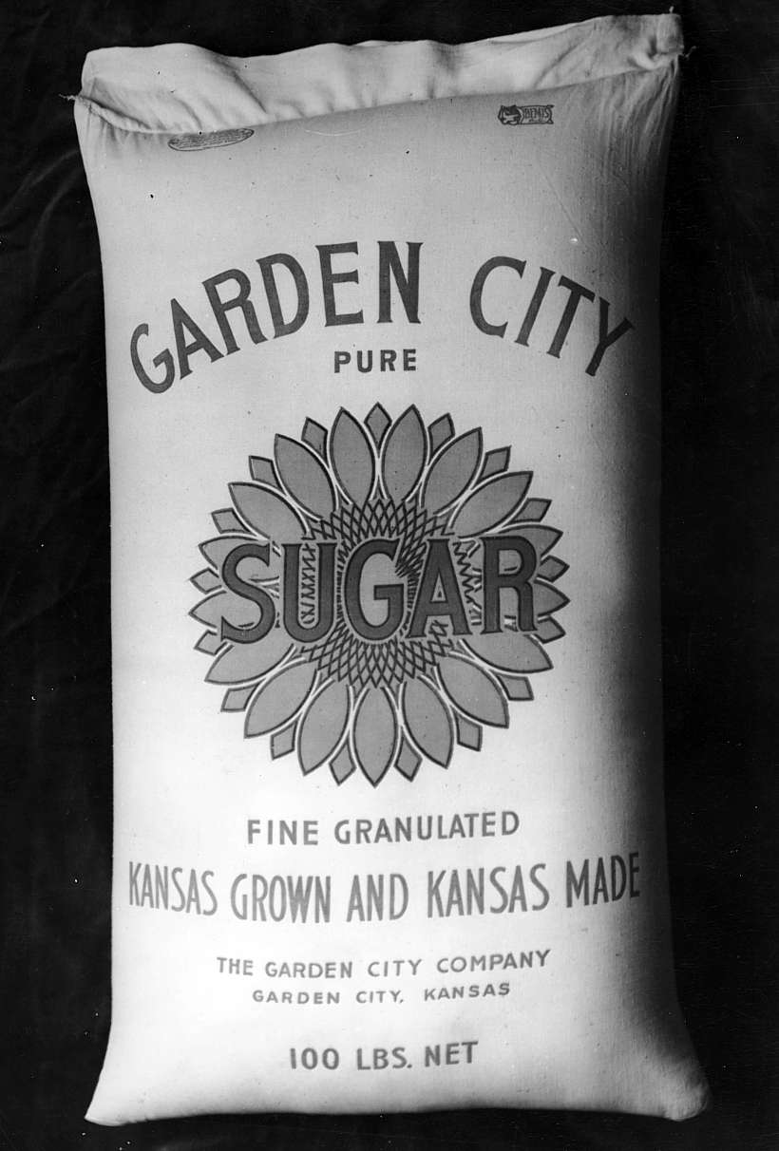
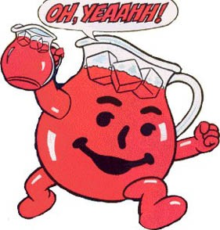
5. Complementary Goods
Goods commonly used with other goods
  Kool-Aid and sugar
  As the price of Kool-Aid falls, the demand for sugar increases

Slide 34

6. Future Price Expectations
Future price expectations – what you expect prices to do in the future
If you expect prices to FALL in the future you will wait to buy it so demand will DECREASE right now (even though prices don’t change now)
If you expect prices to RISE in the future you will buy it now so demand will INCREASE right now (even though prices don’t change now)

Slide 35
Curve Shifts
Increases in demand mean the curve will move to the right
Decreases in demand mean the curve will move to the left

