Slide 1
Jacksonian Democracy Standards
SSUSH7 Investigate political, economic, and social developments during the Age of Jackson.
a. Explain Jacksonian Democracy, including expanding suffrage, the Nullification Crisis and states’ rights, and the Indian Removal Act.
b. Explain how the North, South, and West were linked through industrial and economic expansion including Henry Clay and the American System.
c. Explain the influence of the Second Great Awakening on social reform movements, including temperance, public education, and women’s efforts to gain suffrage.
d. Explain how the significance of slavery grew in American politics including slave rebellions and the rise of abolitionism.

Slide 2
For each of the following pictures take five minutes in your groups to answer the questions.
How does this picture depict the president?
Who does this picture appeal to?
What is the bias of this picture, if any?
Write down any other facts or details you notice in the picture.

Slide 3
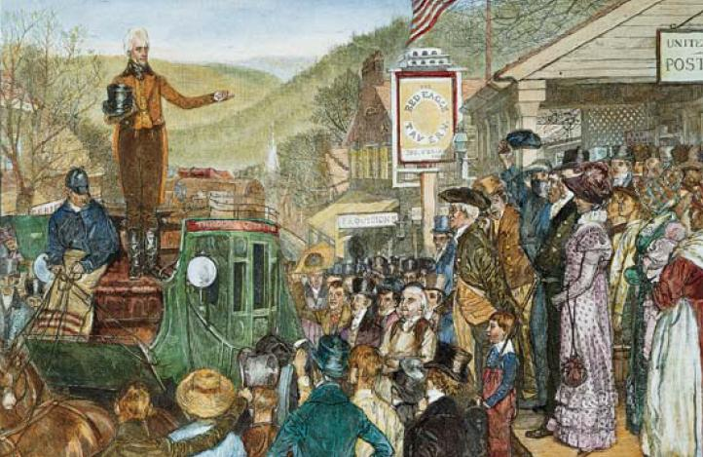

Slide 4
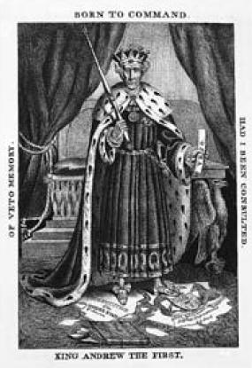

Slide 5
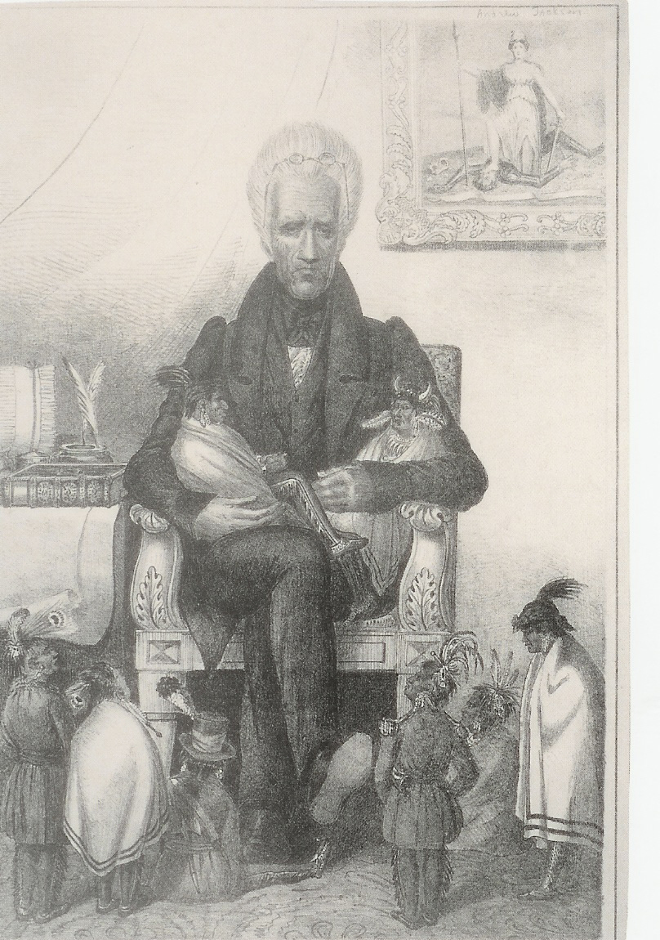

Slide 6
Jacksonian Democracy
Seeking a stronger presidency and a weaker Congress
(look for someone as experienced as…a former general)
Followers and supporters of politicians should be given government jobs to limit power of elite groups (spoils system)
More respect given to the opinions of the common man
Suffrage extended to all white males, not just those that owned land
What kind of president should we expect Andrew Jackson to be?

