Slide 1
Henry Clay

Slide 2
Transportation Revolution

Slide 3
Henry Clay “American system” (1816)
Post-war of 1812, England had surplus goods, making them cheap for American buyers, decreasing demand for American goods.
To help regulate this, Henry Clay (speaker of the house) helped initiate the Tariff of 1816 which increased the price of imported goods.
Tariff was to benefit the weak American manufacturing industry (located where?)
Higher prices for foreign goods made American goods more likely to purchase
Henry Clay proposed the American System:
A government-guided development of industry and ease of trade; attempt to protect economy from European influences:
2nd National Bank to provide a single currency (not state-based),
Improved transportation through the creation of infrastructure (roads and canals)
a protective tariff (Tariff of 1816)

Slide 4
Sectional Implications?
West: Got roads, canals, and federal aid
North- Protective tariffs (helped North Industry)
South- the wealth from tariff in the north would allow northerners to buy farm products from the south
The south thought tariffs made prices high and were not convinced it would help them.
Instead of bringing the nation together, it divided the regions.

Slide 5
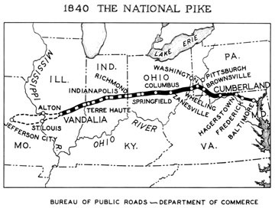
Transportation Revolution
As America expanded westward new methods of transportation were needed.
Improving Roads:
Some states created turnpikes, roads for which users had to pay a toll.
The federal government built the National Road that stretched from Maryland to Missouri.

Slide 6
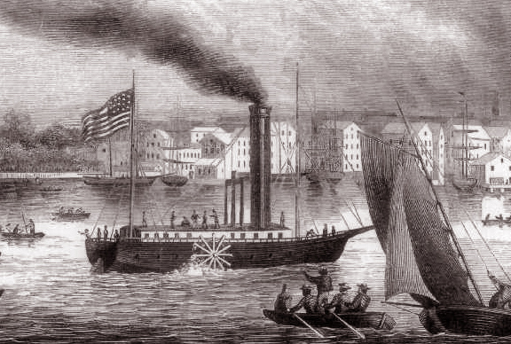
Transportation Revolution
Water travel improves and expands.
Robert Fulton invents the steamboat.
Makes travel upstream easier and faster.
Canals Boom:
These man-made waterways connected various bodies of water, linking farmland in the West to the growing cities of the East.
Erie Canal
Completed in 1825; fueled the growth of New York City and cities along its banks.

Slide 7
Henry Clay’s American System in summary
Tariff of foreign goods to protect American goods
2. Improved national infrastructure (roads)
3. Nation becomes divided because South believed the tariff caused high prices and created idea of sectionalism

