Slide 1
Challenges of the First Five Presidents
(c. 1800-1820’s)

Slide 2
Washington & Adams

Slide 3
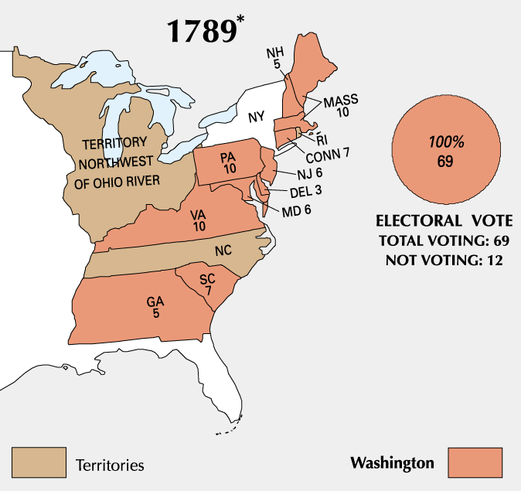

Slide 4
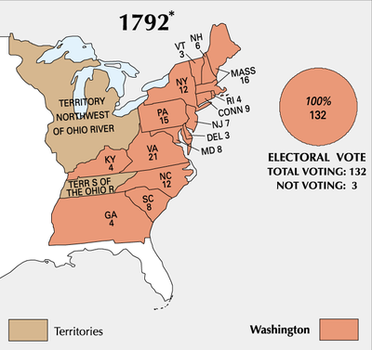

Slide 5
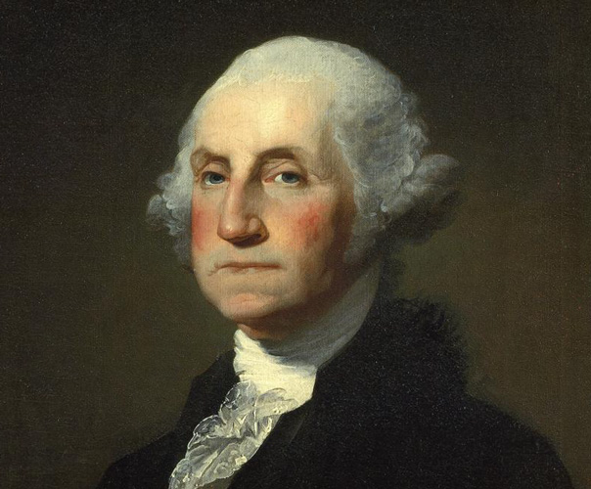
Washington as President
George Washington unanimously elected President by the Electoral College in 1789 and 1792.
Set many precedents that future Presidents would follow.
Created the Presidential cabinet, a group of advisors:
Thomas Jefferson served as Secretary of State
Alexander Hamilton served as Secretary of the Treasury.
Washington also favored non-intervention in Europe and avoided siding with France against Great Britain in their continued fighting.

Slide 6
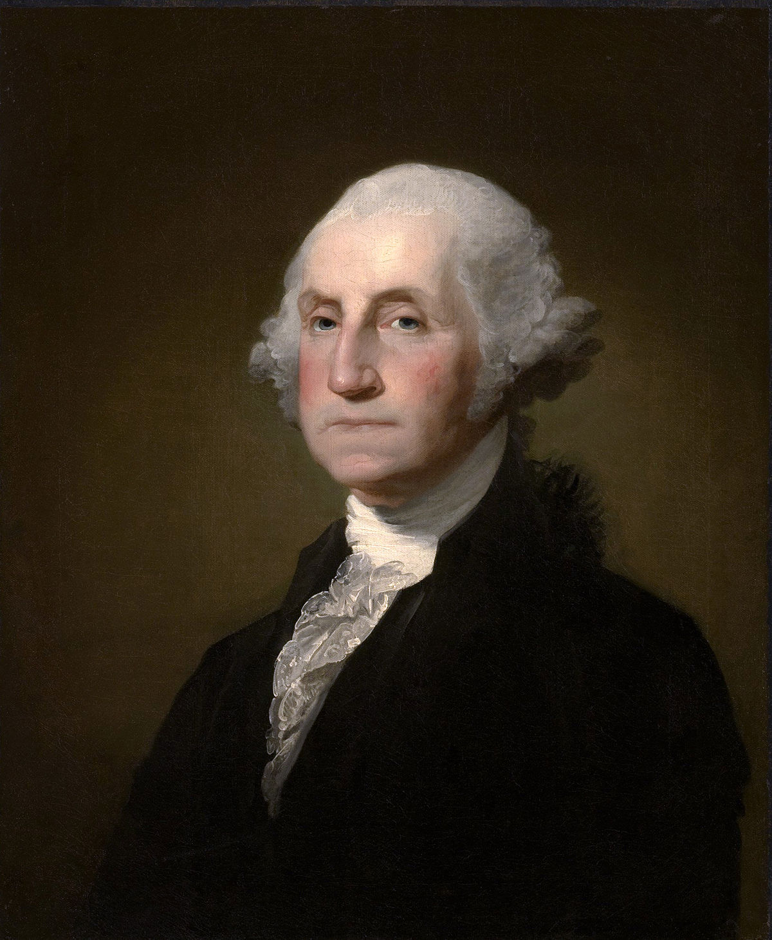
How has the power of the President changed?
Use the census results from 1790 and 2000 to compare and contrast:
1790- 3.9 million people ; 2010- 308 million people

Slide 7
The Whiskey Rebellion
In order to pay back Revolutionary War debt, Washington passed a series of taxes.
One tax in particular hit farmers in Western Pennsylvania hard.
These farmers used excess crop to produce whiskey which they also used as currency.
To protest the new taxes, the farmers led a revolt against tax collectors in the area.

Slide 8
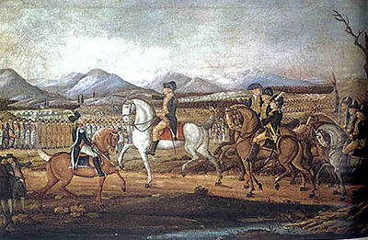
Washington Responds
In order to crush the revolting farmers in Western Pennsylvania, Washington orders in the federal troops.
They quickly force the farmers to disband.
Washington’s quick, firm handling of the Whiskey Rebellion proved that this new Constitution could in fact work.

Slide 9
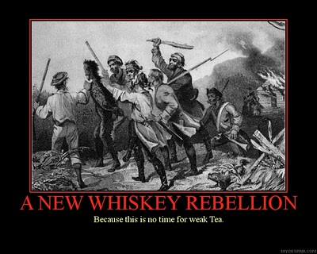

Slide 10
Washington Warns of Political Parties
"It serves to distract the Public Councils, and enfeeble the Public Administration....agitates the Community with ill-founded jealousies and false alarms; kindles the animosity of one....against another....it opens the door to foreign influence and corruption...thus the policy and the will of one country are subjected to the policy and will of another."

Slide 11
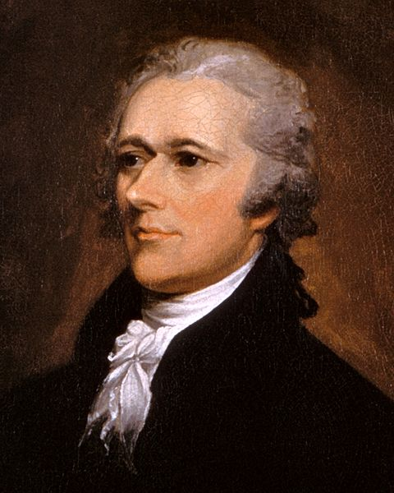
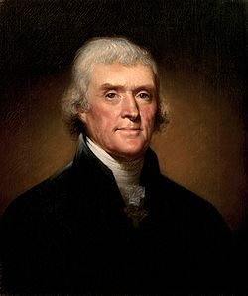
Formation of Political Parties
Political parties had their origin in the difference of opinion between Thomas Jefferson and Alexander Hamilton.
Both men felt differently about how the new nation should be run and operated.
Hamilton’s group (known as the Federalists) wanted to further expand the power of the government and create a national bank.
Jefferson’s group (known as the Democratic-Republicans) believed the federal government should limit itself to powers delegated in the Constitution.

Slide 12
Difference Between Parties
Federalists
Democratic-Republicans
Wealthy
Urban
Loose interpretation of the Constitution
Federal rights
Business
England supporters
Poor
Rural
Strict interpretation of the Constitution
States rights
Agriculture
French supporters

Slide 13
Visions for the Young Republic
Hamilton’s vision
Complex economy
Industrious cities
Global trade
Big business
Jefferson’s vision
Agrarian Republic
Small, farming families
Communities organized around agriculture

Slide 14
France Asks for Help
The French Revolution began in 1789
Tensions between France and England were high, and they were on the verge of war.
Citizen Genêt =French diplomat who came to the US in 1793 to ask the American government to send money and troops to aid the revolutionaries in the French Revolution
President Washington asked France to recall Genêt after Genêt began recruiting men and arming ships in US ports
Washington later relented and allowed Genêt US citizenship upon learning that the new French government planned to arrest Genêt

Slide 15
France Asks for Help
Jefferson (Secretary of State) advised helping France
(When the US was fighting a revolution/ fighting the British, France helped. Now France was fighting a revolution/ fighting the British.)
Hamilton (Secretary of the Treasury) advises non-intervention (stay out of the fight ) (Worried about national debt and political instability in France)
Washington decided not to involve the US in the conflict between England and France, because he believed that it would weaken the young US

Slide 16
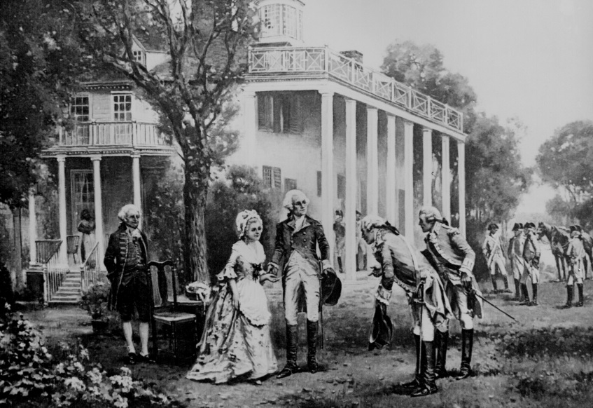
Washington Steps Down
After his 2nd term, Washington announced that he would not seek another four years as President.
Seen as one of the most important things he ever did.
When the announcement was made Jefferson and Hamilton’s respective parties began fighting to replace him.
In Washington’s “Farewell Address” he warned the infant nation about the danger of political parties.

Slide 17
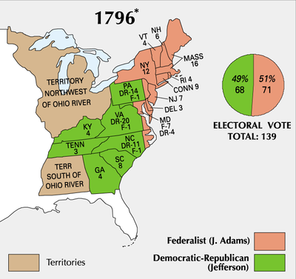

Slide 18
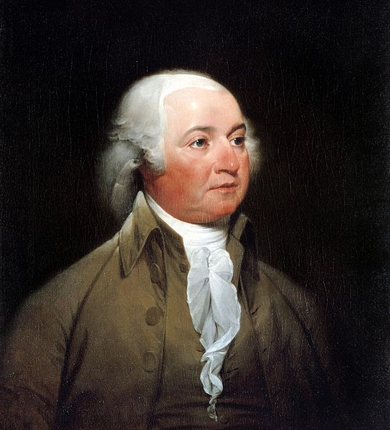
The Presidency of John Adams
2nd President of the US
Defeated Jefferson in 1796 election
Federalist
His administration was plagued by the continuing conflict between England and France and an undeclared war with France with France, known as the Quasi-War

Slide 19
Adams Continues Non-Intervention Policy
Adams found himself at odds with the French in a series of slights (insults) aimed at the United States.
These insults led many Federalists to call for a formal declaration of war on France.
Adams refused to follow his party’s wishes choosing a path of non-intervention.
His refusal to engage in open conflict with the French is seen as one of the most important political decisions of the early nation.

Slide 20
Alien and Sedition Acts
Early political fighting between the D-R’s and the Federalists led to the enactment of the Alien and Sedition Acts in the late 1790s.
These laws were passed by a Federalist–controlled Congress in an attempt to limit political support for Thomas Jefferson and his party.
Alien Act: increased citizenship requirements and simplified the deportation process to prevent Jefferson from receiving support from immigrants.
Sedition Act: An attempt to limit freedom of speech by punishing or imprisoning anyone who spoke out against Federalist’s policies or President Adams himself.

Slide 21
Origin of States’ Rights Ideology
Kentucky and Virginia Resolutions: political statements drafted in 1798 and 1799 respectively
The state legislatures of KY and VA claimed that the federal Alien and Sedition Acts were unconstitutional.
The resolutions argued that states had the right to declare unconstitutional any federal act that was not specifically authorized in the Constitution.
This refusal to follow federal laws is seen to be the beginning of “states’ rights ideology” that will play a large role in the forthcoming Civil War.

Slide 22
Thomas Jefferson & the Louisiana Purchase

Slide 23
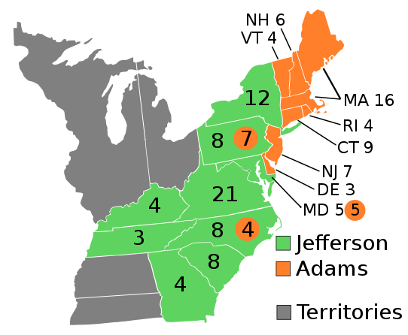
Jefferson Victorious in 1800

Slide 24
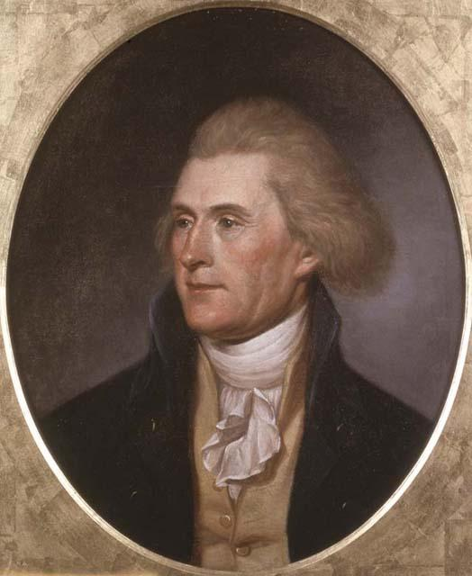
Thomas Jefferson
Democratic-Republican
Plantation Owner from Virginia
States’ Rights supporter
Repealed Alien and Sedition Acts

Slide 25
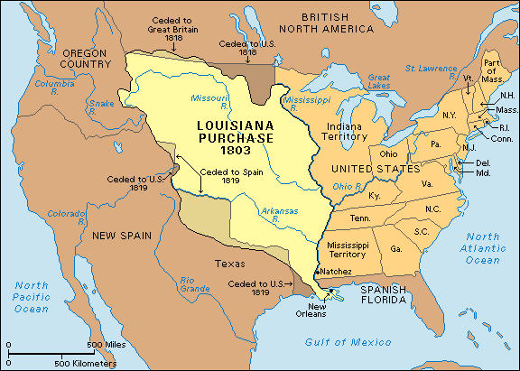
Jefferson’s Purchase from France

Slide 26
The Louisiana Purchase (1803)
The area known as Louisiana switched hands many times, but now was controlled by the French.
President Jefferson, wanting access to the port of New Orleans, decided to make an offer to Napoleon for control of that port.
Napoleon (who was in debt from war) decided to sell Jefferson not just New Orleans but ALL of Louisiana.
The Louisiana Purchase doubled the size of the country and brought with it many valuable resources.

Slide 27
Jefferson’s Dilemma
Thomas Jefferson (as an Anti-Federalist) believed that the power of the federal government (including the President) should be limited.
His views on the Constitution were those of a strict constructionist: meaning that he followed the Constitution “word for word”.
He felt that the purchase of Louisiana was unconstitutional; the Constitution did not specifically give the President the authority to buy territory.
He decided however that the deal was too good to pass up and went through with the purchase.

Slide 28
Exploring Louisiana
No one knew exactly what the lands between the Mississippi River and the Pacific Ocean held.
In an effort to explore the new territory, Jefferson sent out an expedition team headed by Meriwether Lewis and William Clark.
The team charted trails, rivers and mountains, discovered new species and interacted with Native American tribes.
Also staked American claim to the West coast, allowing us to eventually acquire more territory.

Slide 29
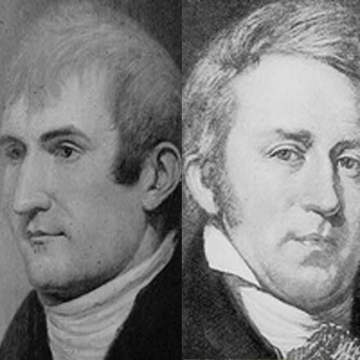
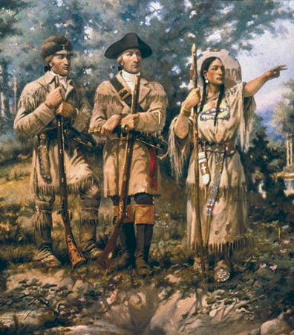
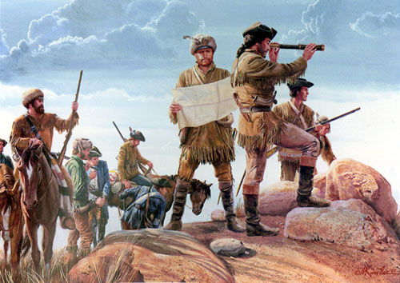

Slide 30
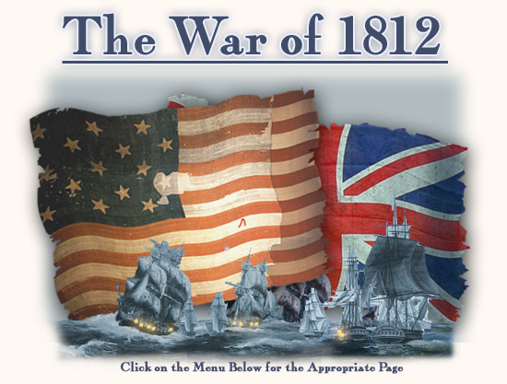

Slide 31
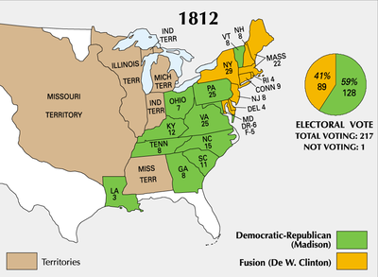

Slide 32
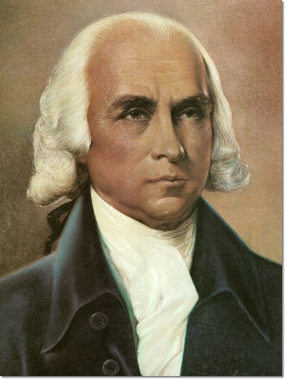
James Madison
Elected President in 1812
Democratic-Republican
“Father of the Constitution”
Co-author of the “Federalist Papers”

Slide 33
Dispute with Great Britain
For the first decade of the 19th century, American merchant ships had been caught in the middle of an on going fight between England and France.
Jefferson was able to avoid war with these countries through diplomacy and economic embargoes.
However hostilities intensified and in 1812, President Madison asked Congress to formally declare war on Great Britain.

Slide 34
Causes of the War of 1812
1. England was interfering with American trade with France.
2. British ships were boarding American vessels and forcing sailors to serve in the British navy, a process called impressment.
3. England had not fully abandoned forts in North America and were helping Native Americans fight westward settlers.
4. America wanted to invade Canada and take it from English control.

Slide 35
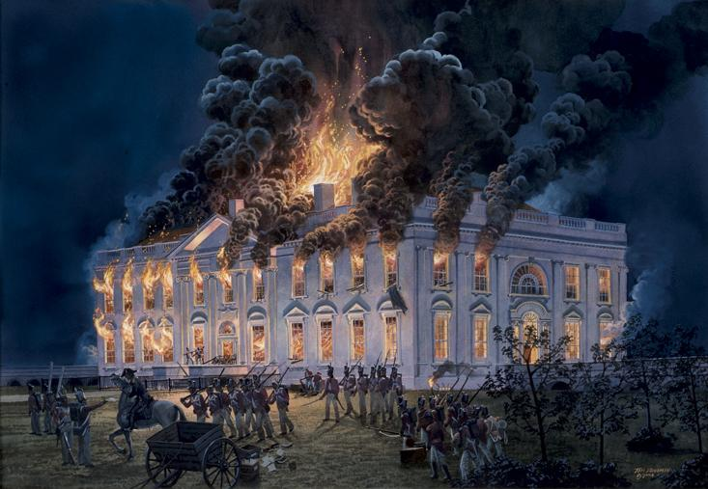

Slide 36
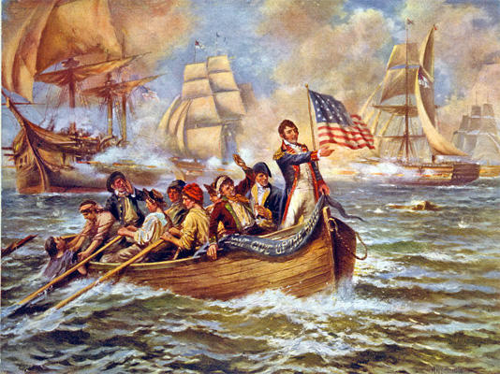
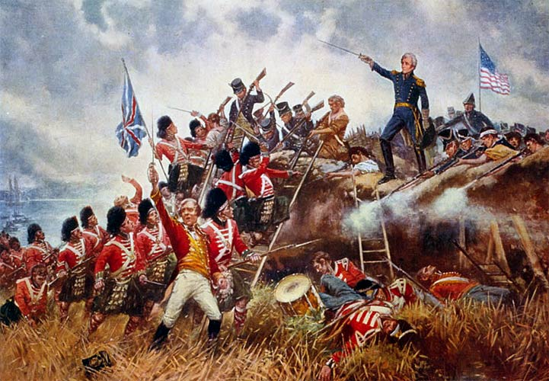
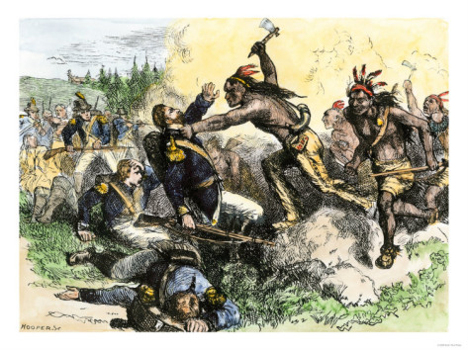

Slide 37
Results of the War of 1812
War ended in a draw.
America neither lost nor gained any new territory.
Increased respect for American army and navy throughout the world
End to Native American resistance in the Ohio River Valley
Signaled an end to the Federalist Party, who refused to support the war.
Stimulated American industry
Final official dispute with England

Slide 38
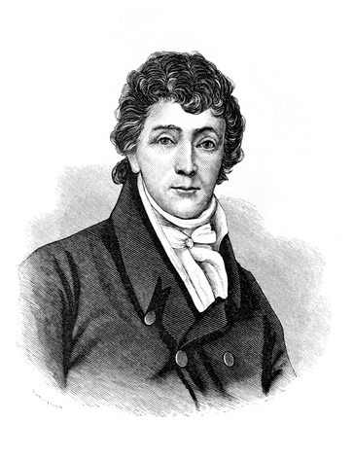
Star-Spangled Banner
While imprisoned on a British ship, Francis Scott Key penned “The Star-Spangled Banner”.
The song embodied a new spirit for the American people.
Even after being independent of England for over 30 years, many still held to their English roots.
The “victory” in the War of 1812 ushered in a period of intense nationalism and pride in being an America.

Slide 39
The Monroe Doctrine

Slide 40
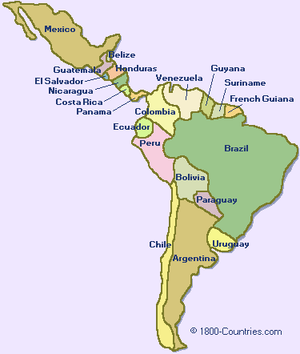
The Americas Gain Independence
During the early 1800s, many Central and South American nations gained their independence from Spain and Portugal.
In the 1820s, these European nations set their sights on recolonizing these recently freed nations.

Slide 41
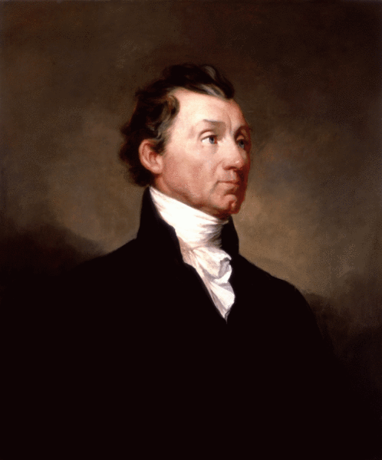
The Monroe Doctrine
In reaction to this attempt to recolonize parts of Central and South America, American President James Monroe issued the “Monroe Doctrine” in 1823.
The doctrine stated that the United States would not tolerate Europeans meddling in the affairs of the Western hemisphere.

Slide 42
Monroe Doctrine
The occasion has been judged proper for asserting, as a principle in which the rights and interests of the United States are involved, that the American continents, by the free and independent condition which they have assumed and maintain, are henceforth not to be considered as subjects for future colonization by any European powers.
- Monroe Doctrine
December 2, 1823

Slide 43
Ticket Out the Door
You are an American living in the year 1823.
You are upset at the prospect that European countries might attempt to recolonize your neighbors to the south.
Create a protest sign that clearly relates your disgust at this idea of re-colonization.
Your sign must include the following words:
1. Monroe Doctrine
2. Europe
3. Western Hemisphere

