Slide 1
American Expansion Notes Continued

Slide 2
Erie Canal
Provided a new shipping route from Lake Erie to the Hudson River (New York City)
The canal helped make New York a dominant commercial center by expanding new markets.
It also allowed people to travel more cheaply, carrying their household goods with them.
The Erie Canal greatly enhanced the economy of New York City.

Slide 3
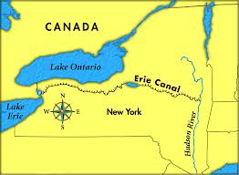

Slide 4
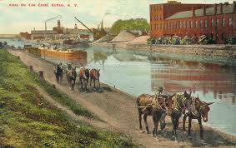

Slide 5
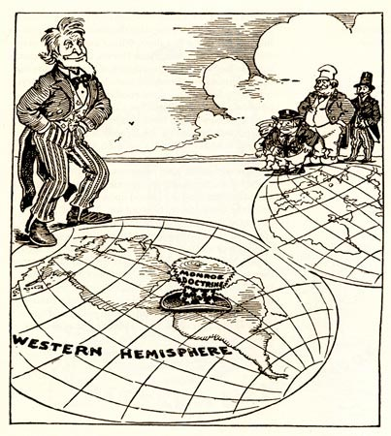

Slide 6
Monroe Doctrine
Issued by President Monroe
The U.S. would not tolerate European intervention in the affairs of any independent nation in the Americas.
No more European colonization!!

