Slide 1
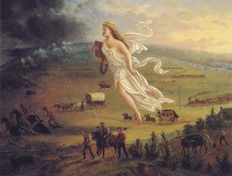
So….we won the Revolution and we have a Constitution, now what?....

Slide 2
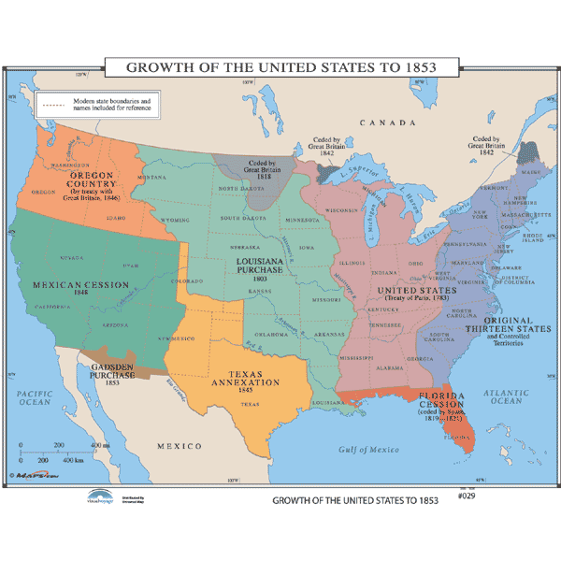
So….we won the Revolution and we have a Constitution, now what?....

Slide 3
Agenda for the day
Elbow Room clip
Far and away clip
What does the U.S. look like at this point?
Jigsaw key terms
Fill in notes
Small group activity: “America Expands visual”
Race cars review (use word wall-listening)

Slide 4
Jigsaw terms
Manifest Destiny
Northwest Ordinance
Lewis and Clark Expedition
Louisiana Purchase
War of 1812
Erie Canal
Monroe Doctrine
Trail of Tears

Slide 5
Manifest Destiny

Slide 6
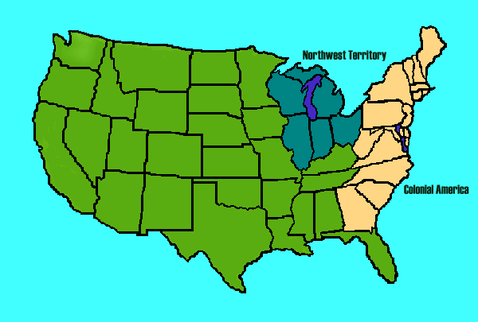
Northwest Ordinance

Slide 7
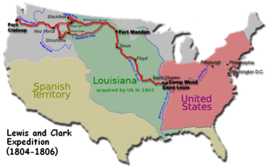
Lewis and Clark Expedition

Slide 8
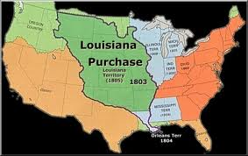
Louisiana Purchase

Slide 9
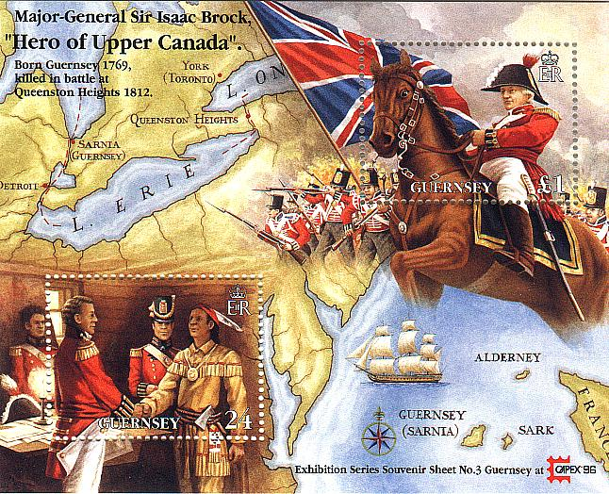
War of 1812

Slide 10
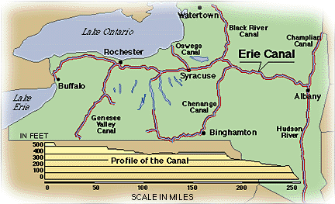
Erie Canal
What is it?
An artificial waterway where ships could carry goods and people. It connected New York City to the Great Lakes.
Why is it important?
It made New York City a major economic center and increased its population.

Slide 11
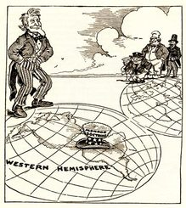
Monroe Doctrine

Slide 12
Indian Removal Act/Trail of Tears

